Slide 1
Design of Smart Contracts in Decentralized Systems
Group 5
Krishna Harendra Maradapu
JayaChandra Battula
Divya Kattegummula
Rahul Ram Grandhi

Slide 2


Introduction to Smart Contracts

Slide 3
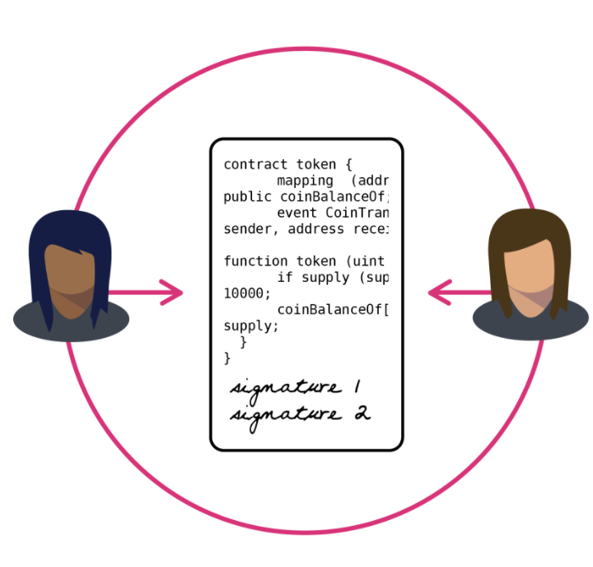
What are Smart Contracts
Proof of agreement on blockchain.
Cannot be reverted and its trace is public and immutable.
Can send, receive and store money.
Interact with other smart contracts or any computational systems

Slide 4
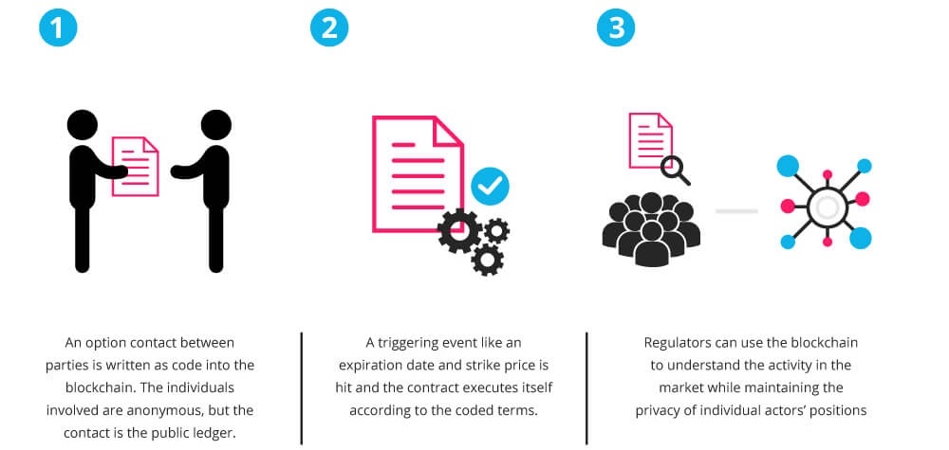
How do they work

Slide 5
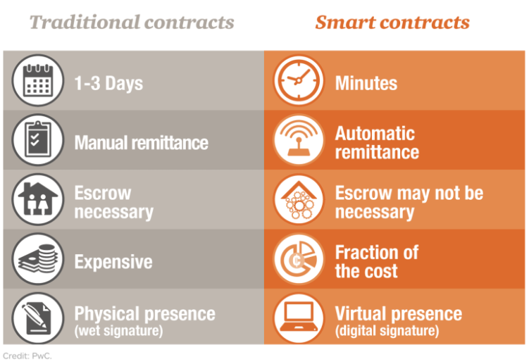
Traditional Contracts
VS
Smart Contracts
Notes:
https://www.contractworks.com/blog/smart-contracts-vs.-traditional-contracts

Slide 6
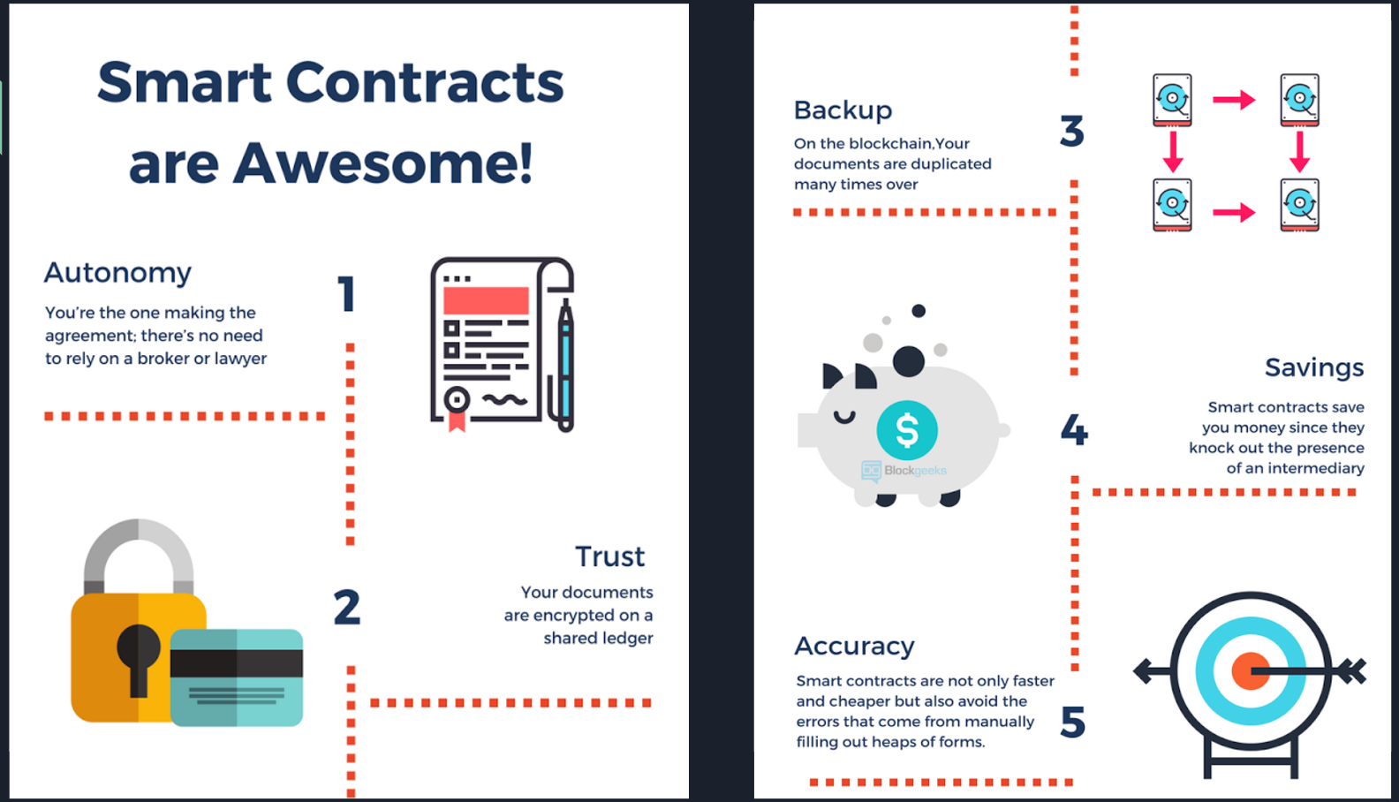

Slide 7
Example – Apartment Rental
Rental fee payment
Digital Key Created
Contract
Date
Held until contract date
Held until contract date
Funds Released
Key Released

Slide 8

Ethereum in Smart Contracts

Slide 9

What is Ethereum ?
Ethereum is a decentralized platform that runs smart contracts
Notes:
It's worth noting that bitcoin was the first to support basic smart contracts in the sense that the network can transfer value from one person to another. The network of nodes will only validate transactions if certain conditions are met.
But, bitcoin is limited to the currency use case.
By contrast, ethereum replaces bitcoin's more restrictive language (a scripting language of a hundred or so scripts) and replaces it with a language that allows developers to write their own programs.
Ethereum allows developers to program their own smart contracts, or 'autonomous agents', as the ethereum white paper calls them. The language is 'Turing-complete', meaning it supports a broader set of computational instructions.
Smart contracts can:
Function as 'multi-signature' accounts, so that funds are spent only when a required percentage of people agree
Manage agreements between users, say, if one buys insurance from the other
Provide utility to other contracts (similar to how a software library works)
Store information about an application, such as domain registration information or membership records.

Slide 10
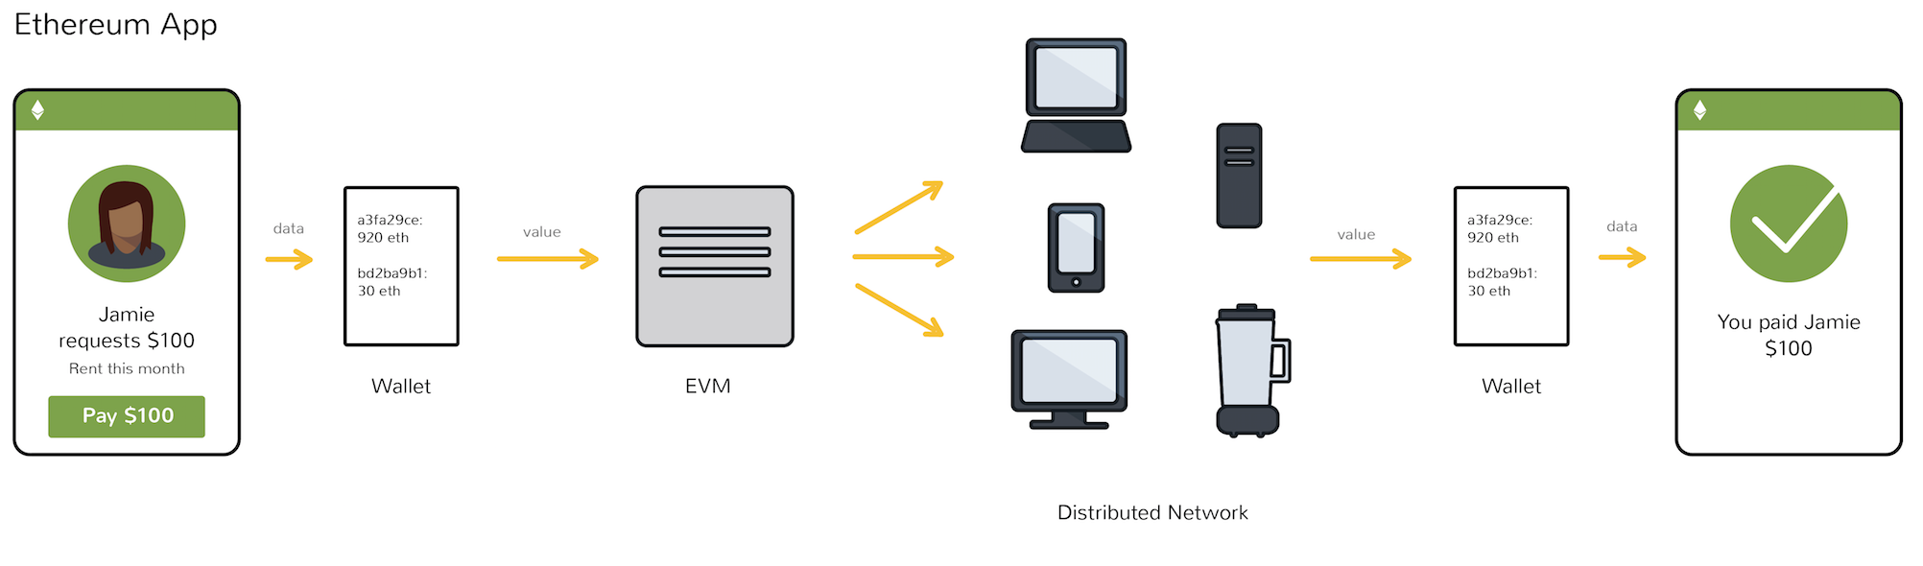
Ethereum Virtual Machine (EVM)
Notes:
https://www.coindesk.com/information/how-ethereum-works/

Slide 11
Tokens
What is a token?
A term to refer to a unit of value issued by a private entity.
What is the need for tokens? (Tokens over Ether)
because there are tons of places where we use a form of token over cash.
How are tokens created?
Smart contracts
Creating tokens: http://thetokenfactory.com.

Slide 12
ERC-20
What is ERC-20?
technical standard used for smart contracts on the Ethereum blockchain.
Ethereum Request for Comments.
ERC-20 token standards
ERC-20 defines 6 mandatory functions and 3 optional functions which needs to be implemented in the smart contract
3 optional functions:
string public constant name = "Bank Payroll system";
string public constant symbol = "GRP5";
uint8 public constant decimals = 18; // depicts the number of decimals it should support

Slide 13
ERC-20
6 mandatory functions
// ERC Token Standard #20 Interface
contract ERC20Interface {
function totalSupply() public constant returns (uint);
function balanceOf(address tokenOwner) public constant returns (uint balance);
function transfer(address to, uint tokens) public returns (bool success);
function transferFrom(address from, address to, uint tokens) public returns (bool success);
function approve(address spender, uint tokens) public returns (bool success);
function allowance(address tokenOwner, address spender) public constant returns(uint remaining); }

Slide 14
ERC-20
Advantages of ERC-20
Simple, quick and efficient.
Limitations
Financial loss.
Further studies are going on Ethereum standards and the community is proposing two new standards ERC-223 and ERC-721.

Slide 15
Employee Payroll System
Use Case

Slide 16
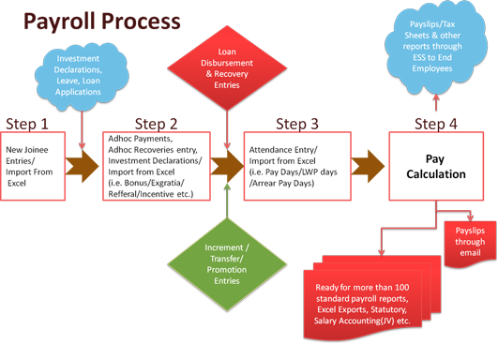
Traditional Payroll System

Slide 17
Payroll System using Smart Contract
Company
Employee
<Smart Contract>
No third party is required

Slide 18
Technologies

Slide 19

Solidity
Contract-oriented, high-level language for implementing smart contracts.
Influenced by C++, Python and JavaScript and is designed to target the Ethereum Virtual Machine (EVM).
Statically typed, supports inheritance, libraries and complex user-defined types among other features.

Slide 20
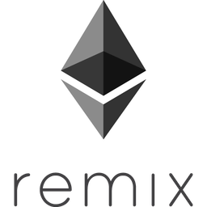
Remix
Integrated development environment (IDE) for smart contract development
Focuses on the development and deployment of Solidity written smart contracts.

Slide 21
Solidity by Example
https://remix.ethereum.org
Notes:
pragma solidity ^0.4.0;
contract HelloWorldContract{
string word="Hello World";
function setWord(string newWord) public {
word=newWord;
}
function getWord() public constant returns (string){
return word;
}
}

